Slide 2

Natural Language Processing
Large Language Models - ChatGPT
Mamatha.H.R
Department of Computer Science and Engineering

Slide 3

NATURAL LANGUAGE PROCESSING
GPT-3
GPT-3 (Generative Pre-trained Transformer 3) is a language model that was created by OpenAI. The 175-billion parameter deep learning model is capable of producing human-like text and was trained on large text datasets with hundreds of billions of words.

Slide 4
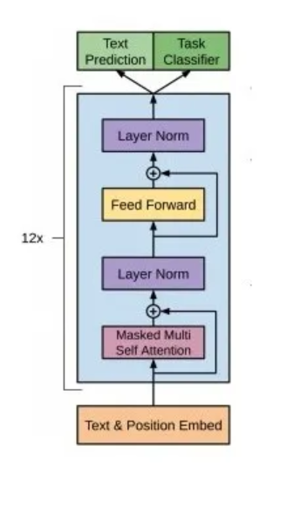
NATURAL LANGUAGE PROCESSING
GPT - 3 Architecture
GPT uses an unmodified Transformer decoder, except that it lacks the encoder attention part. The GPT, GPT2, GPT 3 is built using transformer decoder blocks. BERT, on the other hand, uses transformer encoder blocks. GPT-3 was trained with huge Internet text datasets — 570GB in total. When it was released, it was the largest neural network with 175 billion parameters (100x GPT-2).GPT-3 has 96 attention blocks that each contain 96 attention heads

Slide 5
NATURAL LANGUAGE PROCESSING
ChatGPT
It is a variant of the popular GPT-3 (Generative Pertained Transformer 3) model, which has been trained on a massive amount of text data to generate human-like responses to a given input. Chat GPT was modified and improved using both supervised and reinforcement learning methods, with the assistance of human trainer (RLHF).Chat GPT also has 176 billion parameters same as GPT -3 model. The learning includes 3 Steps.
Pre-Training
Supervised Fine-Tuning
Reinforcement Learning with Human Feedback (Reward Model and Proximal Policy Optimisation)

Slide 6
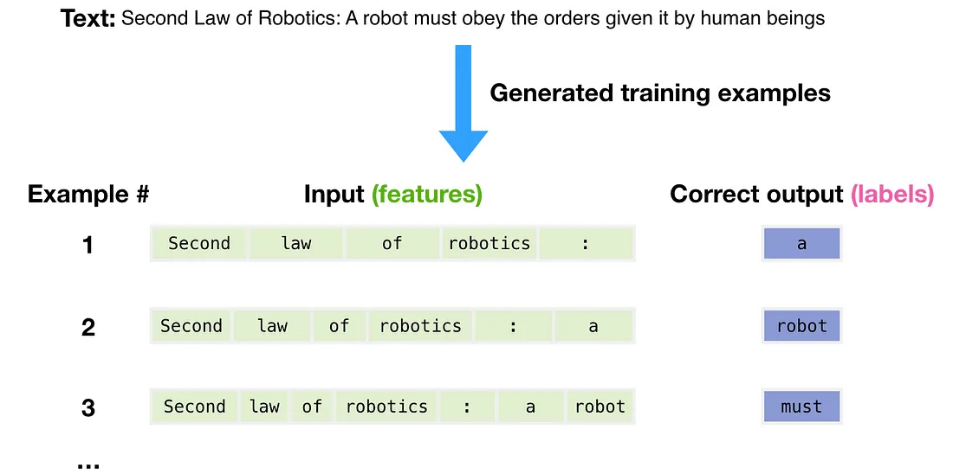
NATURAL LANGUAGE PROCESSING
GPT-3 Training
The dataset of 300 billion tokens of text is used to generate training examples for the model. For example, these are three training examples generated from the one sentence

Slide 7
NATURAL LANGUAGE PROCESSING
GPT-3 Training
Model is predicting one token at a time since it is auto regressive model. First time the model’s prediction will be wrong. We calculate the error by showing the correct output and update the model parameters, so next time it makes a better prediction. This process will be repeated many times.

Slide 8
NATURAL LANGUAGE PROCESSING
GPT-3 Supervised Fine Tuning
In first Step a pretrained GPT-3 model is used and it will be fine tuned with the help of labelers by creating a supervised dataset. Input Queries were collected from the actual user entries and model generated different responses with respect to that input prompts. The labelers then wrote an appropriate response to the input prompt’s (how they want to see that prompt to be answered).The GPT-3 model was then fine-tuned using this new supervised dataset, to create GPT-3.5 model.

Slide 9
NATURAL LANGUAGE PROCESSING
GPT-3 RLHF (Reward Modelling)
In this step SFT model is used and different input/prompts queries fed to the finetuned model and different responses were generated (4 to 7)for every input/prompt. Then labeler determines a reward for each of these outcomes and this reward is proportional to the quality of response with respect to initial prompt .The Labeler rank the output's in sequence order of best to worst. Then we can use this data in order to train a reward model . The input for a reward model will be the user prompt and one of the responses we generated and output will be a scaler value which determines the quality of response with respect to the input prompt. Also we use rankings that we generated in the past in order to train this reward model.

Slide 10
NATURAL LANGUAGE PROCESSING
GPT-3 - RLHF (Proximal Policy Optimisation)
Once we get the response from the model this will be passed to the trained reward model. This will tell us the quality of response with respect to the input sequence. With this reward we can update the parameters of clone SFT model .The GPT model updated via PPT Proximal policy optimization
Goal of PPO-:Maximize the total reward of responses generated from the model by including reward in the Loss. If the response is very good the product of r and Advantage function (A^) will be large. If the advantage function will be negative the response will be bad.

Slide 11
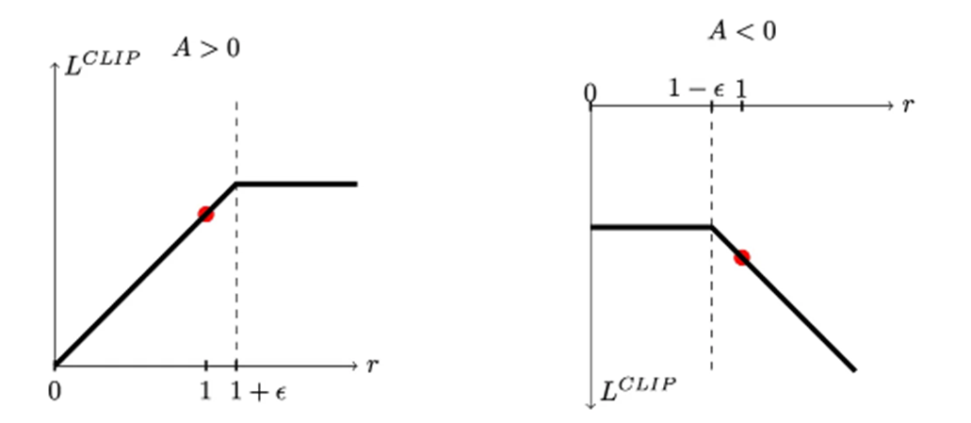
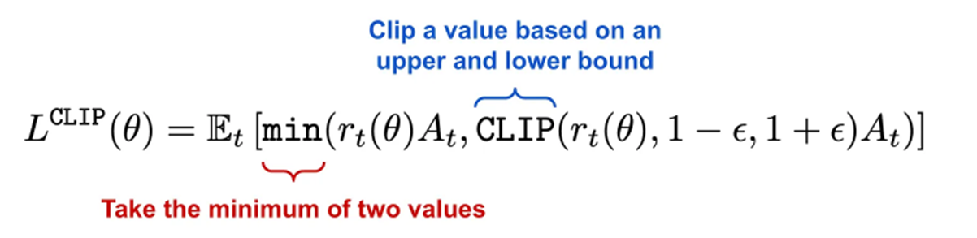
NATURAL LANGUAGE PROCESSING
Proximal Policy Optimisation
The PPO ensures that if the model is performing well (A>0) the reward score is very small and becomes stagnant after a certain point, but if the model is performing badly (A<0) it ensures that the penalising score is a certain minimum and can increase infinitely (no limit on the penalising score)

Slide 12
NATURAL LANGUAGE PROCESSING
Direct Preference Optimisation (DPO)
Limitations of RLHF and PPO:
Gathering Human feedback is extremely difficult
Modelling a reward function without extensive reinforcement learning expertise is difficult.
Hence, a new method called DPO was introduced

Slide 13
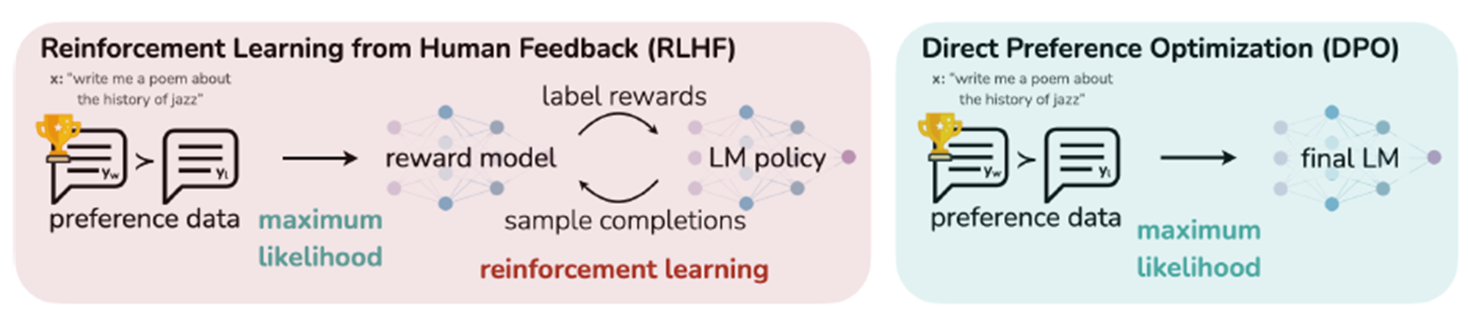
NATURAL LANGUAGE PROCESSING
Direct Preference Optimisation (DPO)
DPO, treats the constrained reward maximization problem as a classification problem on human preference data. This approach is stable, efficient, and computationally lightweight. It eliminates the need for reward model fitting, extensive sampling, and hyper-parameter tuning

Slide 14
NATURAL LANGUAGE PROCESSING
Course References
Text Book:
1. “Introduction to Natural Language Processing”, Jacob Eisenstein, MIT Press, Adaptive computation and Machine Learning series, 18th October, 2019.
The open source softcopy is available at githubhttps://github.com/jacobeisenstein/gt-nlp class/blob/master/notes/eisenstein-nlp-notes.pdf.
Reference Books:
1: “Speech and Natural Language Processing”, Daniel Jurafsky and James H. Martin, 2nd edition paperback,2013.
The more up to date 3rd edition draft is available at http://web.stanford.edu/~jurafsky/slp3/

